Slide 1

MICRO CREDIT DEFAULTER - PREDICTION

Slide 2
SUBMITTED BY Steffin Varghese
MICRO CREDIT DEFAULTER - PREDICTION

Slide 3
INTRODUCTION
A Microfinance Institution (MFI) is an organization that offers financial services to low-income populations. Microfinance services (MFS) becomes extremely useful when targeting especially the unbanked poor families living in remote areas with not much sources of income. The MFS provided by MFI are Group Loans, Agricultural Loans, Individual Business Loans and so on. Many microfinance institutions (MFI), experts and donors are supporting the idea of using mobile financial services (MFS) which they feel are more convenient and efficient, and cost saving, than the traditional high-touch model used since long for the purpose of delivering microfinance services.
Though, the MFI industry is primarily focusing on low-income families and are extremely useful in such areas, the implementation of MFS has been uneven with both significant challenges and successes.

Slide 4
Understanding the Problem
Today, microfinance is widely accepted as a poverty-reduction tool, representing 70 billion USD in outstanding loans and a global outreach of 200 million clients.
Many developing nations rely heavily on microfinance institutions to support their economies. However, due to the informal nature of the businesses and people they lend money to, many of these microfinance companies struggle with the issue of default.
We are working with one such client that is in Telecom Industry. They are a fixed wireless telecommunications network provider. They have launched various products and have developed its business and organization based on the budget operator model, offering better products at Lower Prices to all value conscious customers through a strategy of disruptive innovation that focuses on the subscriber.
They understand the importance of communication and how it affects a person’s life, thus, focusing on providing their services and products to low-income families and poor customers that can help them in the need of hour. They are collaborating with an MFI to provide micro-credit on mobile balances to be paid back in 5 days.

Slide 5
Steps in Exploratory Data Analysis
Loading the dataset
Characteristics of Dataset
Exploring Categorical Variables
Checking for Missing Values
Correlation
Statistical Summary
Data Visualization
Distribution of Data
Checking the Skewness and Outliers
Data Cleaning
OverSampling
PCA Techniques
Pre-processing

Slide 6
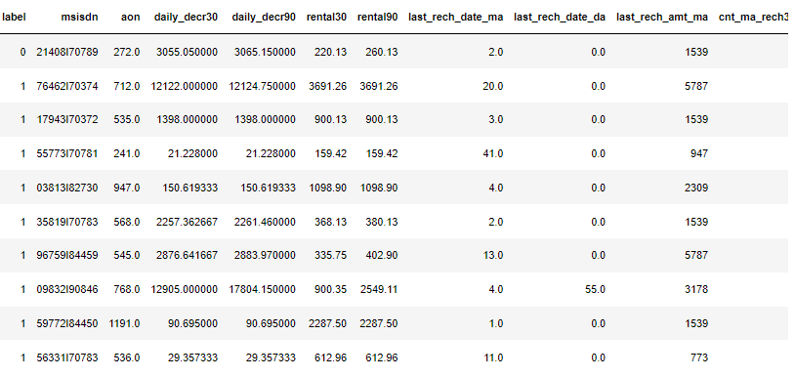
Data Sources and their formats
The sample data is provided to us from our client database. It is hereby given to you for this exercise. In order to improve the selection of customers for the credit, the client wants some predictions that could help them in further investment and improvement in selection of customers.
There are no null values in the dataset.
There may be some customers with no loan history.
The dataset is imbalanced. Label ‘1’ has approximately 87.5% records, while label ‘0’ has approximately 12.5% records.
For some features, there may be values which might not be realistic. You may have to observe them and treat them with a suitable explanation.
You might come across outliers in some features which you need to handle as per your understanding. Keep in mind that data is expensive, and we cannot lose more than 7-8% of the data.
We have 209593 records in this dataset. We have 209593 rows and 37 columns in the dataset.
We have string, integer, and float type of data in the dataset.
We have 209593 non null values in the dataset.

Slide 7
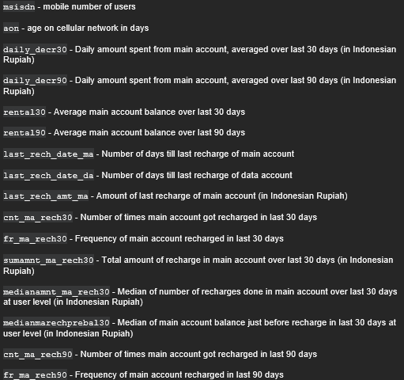
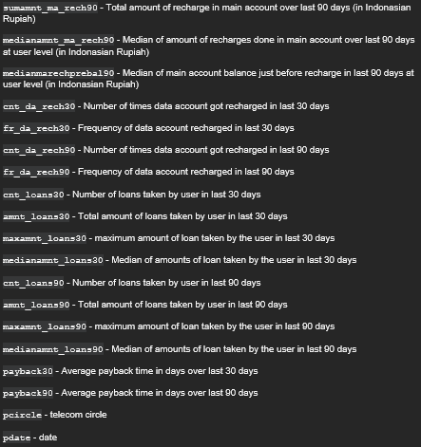
Data Variable Description
Features in Dataset (Independent Variable)

Slide 8

Target in dataset (Dependent Variable)

Slide 9
Data Preprocessing
The column 'pcirlce' has only one value for all the records. So, we dropped this column from the dataset.
The first column is just indexed to identify each records. So, we dropped this column as it is not making any impact on the output.
We have also dropped the column ‘msisdn’ as it contains the user mobile number.
As a feature engineering, we have extracted the day and month from the column ‘pdate’ and added them to the dataset as new columns.

Slide 10
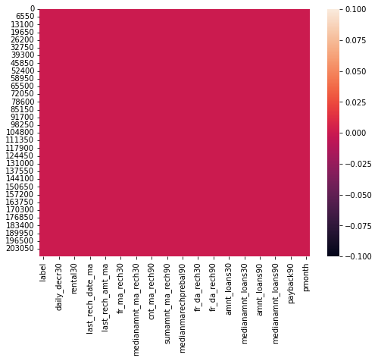
Checking for Missing Values
We don’t have any missing values in the dataset
Heatmap of null values

Slide 11
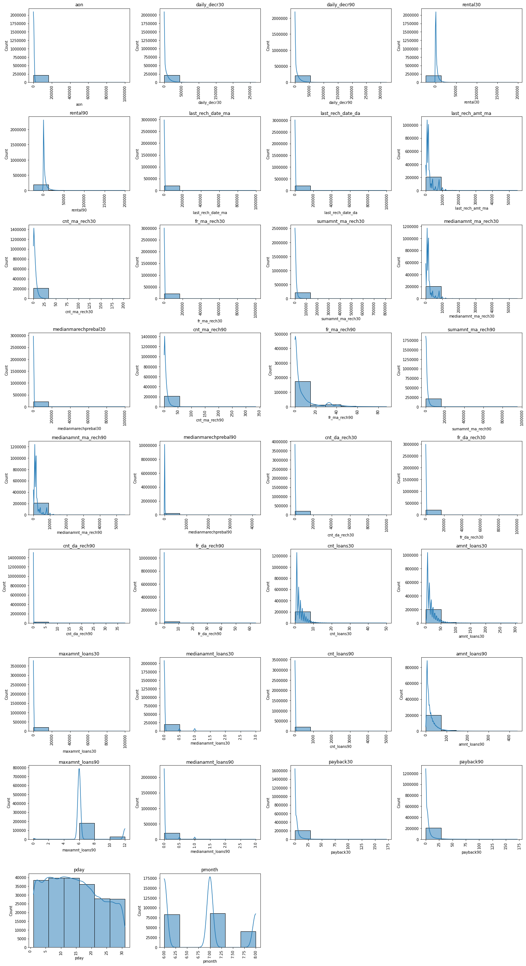
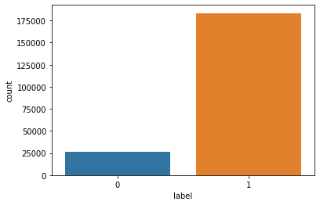
Data Visualization
Univariate Analysis

Slide 12
Observations:
The average age on cellular network in days for customers ranging between -48 to 1.7 lakh.
Most customers have spent less than Rs. 44,000 from main account averaged over last 30 and spent more than Rs. 53,000 over last 90 days.
The average main account balance of most of customers are ranging between Rs. -23000 to Rs. 14000 over last 30 days and Rs. -25000 to Rs. 13000 over last 90 days.
The average number of days from recharge of main account and data account for most of customers ranging between -29 to 1.67 lakh.
Most customers have recharged their main account for an amount ranging between Rs. 0 to Rs. 9000.
The number of times customers recharged their main account in last 30 days is ranging between 0 to 34 times and in last 90 days is ranging between 0 to 56 times
Frequency of main account recharge for most of the customers in last 30 days is ranging between 0 to 1.67 lakh and in last 90 days is ranging between 0 to 14.67.
Total amount of recharge for most of the customers for their main account in last 30 days is between the range Rs. 0 to Rs. 1.35 lakh and the median amount is between the range Rs. 0 to Rs. 9000. While the total amount of recharge for their main account in last 90 days is ranging between Rs. 0 to Rs. 1.59 lakh and the median amount of recharge is between Rs. 0 to Rs. 9000.
The median main balance of most of customers just before recharge in last 30 days is between Rs-200 to Rs. 1.67 Lakh and in last 90 days is between Rs. 200 to Rs. 6700.
Most of the customers have recharged their data account between 0 to 16000 times in last 30 days and 0 to 6.33 times in last 90 days.
The frequency of recharge for most of customers for their data account is ranging from 0 to 1.67 lakh times in last 30 days and 0 to 11 times in last 90 days.
Most customers have recharged their data account between 0 to 1.67 lakh times in last 30 days and 0 to 6 times in last 90 days.
Number of loans taken by most customers is between 0 to 8 times in last 30 days and 0 to 832 times in last 90 days
Total amount of loan taken by most customers is ranging between Rs. 0 to Rs. 51 in last 30 days and Rs. 73 in last 90 days.
Maximum amount of loan taken by most customers is between Rs. 0 to Rs. 17000 in last 30 days and Rs. 2 in last 90 days.
Median amount of loan taken by most customers is between Rs. 0 to Rs. 0.5 in last 30 days and Rs. 0.5 in last 90 days
Average payback time for most customers is between the range 0 to 28 days over last 30 and 90 days.
The data was collected for three months: - June, July, and August. The data is uniform for most of the days, but a greater number of data is collected from the beginning of the month, and it is reducing towards the end of month.
Most of the customers have paid back the credit amount within 5 days of issuing loan amount.

Slide 13
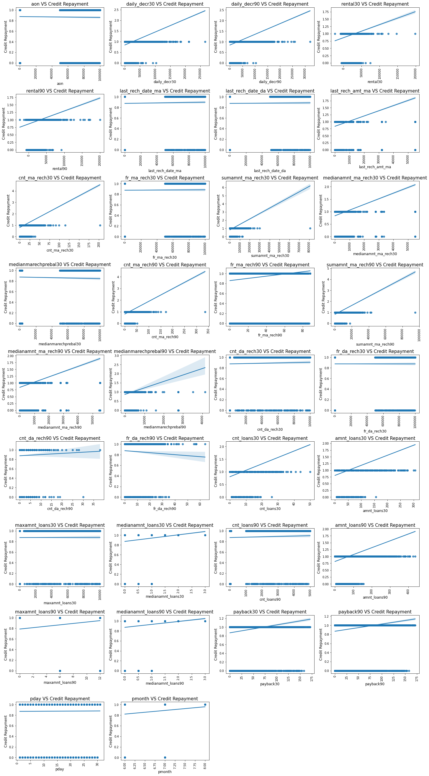
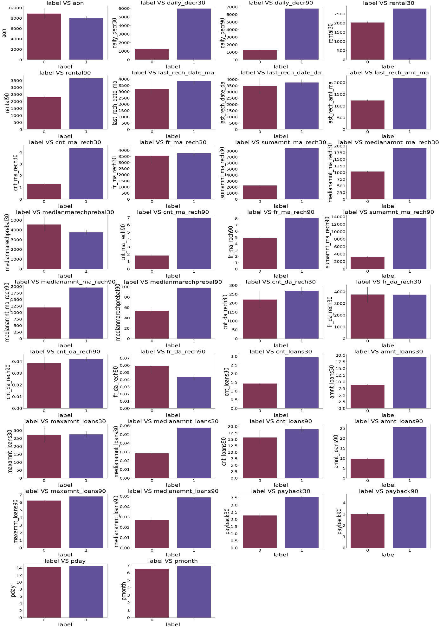
Bivariate Analysis

Slide 14
Observations:
Age of cellular network in days is not having much impact on the loan defaulters. The number of credit defaulters are slightly higher if the age of cellular network is higher.
Customers who have least amount of spent from main account over last 30 and 90 days are more likely to be a defaulter.
Customers who maintain low average main account balance over last 30 and 90 days are more likely to be a defaulter.
Customers who had a greater number of recharges of main account and data account in past 30 and 90 days are not likely to be a defaulter.
Customers who have recharged main account for higher amount have made the repayment of credit on time.
Customers who are having frequent recharges in last 30 and 90 days are less likely to be a defaulter.
Customers whose total amount and median amount of recharge in last 30 and 90 days is lower are more likely to be a defaulter.
Customers who have higher median main balance just before last recharge in 30 days are more likely to be a defaulter, while the customers who have higher median main balance just before last recharge in 90 days are less likely to be a defaulter.
Customers who have higher number of data account recharges in last 30 and 90 days are less likely to be a defaulter.
Customers who have higher frequency in recharge of data account in last 90 days are more likely to be a defaulter, while the frequency of recharges of data account in last 30 days is not having much impact on identifying whether the customer will be a defaulter or not.
Most number of customers who have taken most number of loans and higher amount of loan over the last 30 days and 90 days are less likely to be a defaulter.
Maximum amount taken by customers as loan over the last 30 and 90 days are not providing much information on whether the customer would be a defaulter or not.
Customers who have higher median loan amount over the last 30 and 90 days are less likely to be defaulter.
Customers who payback the amount in more days over the last 30 and 90 days are less likely to be a defaulter.
The day and month of which the data was collected is not having much impact on the identifying whether the customer would be a defaulter or not.

Slide 15
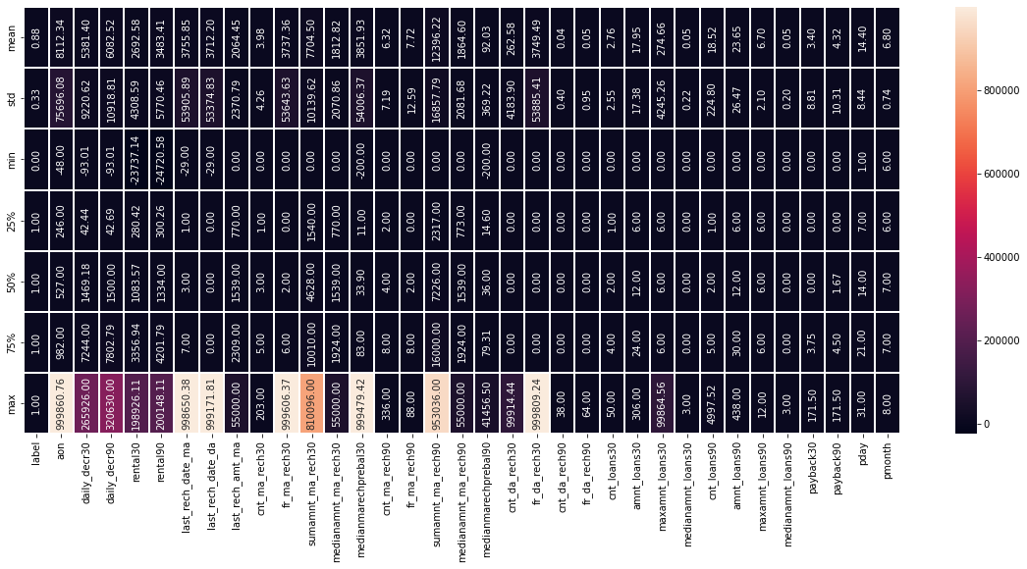
Statistical Summary
Observations:
All the columns except the column 'label' are having higher mean value than the median value. That means the data in these columns are skewed and data is not normally distributed.
Except the columns ['label', 'medianamnt_loans30', 'maxamnt_loans90', 'medianamnt_loans90', 'pday', 'pmonth'], rest of the columns are having huge difference between the 75% and the maximum value. That means possible outliers are present in the data.
Heatmap of describe of data

Slide 16
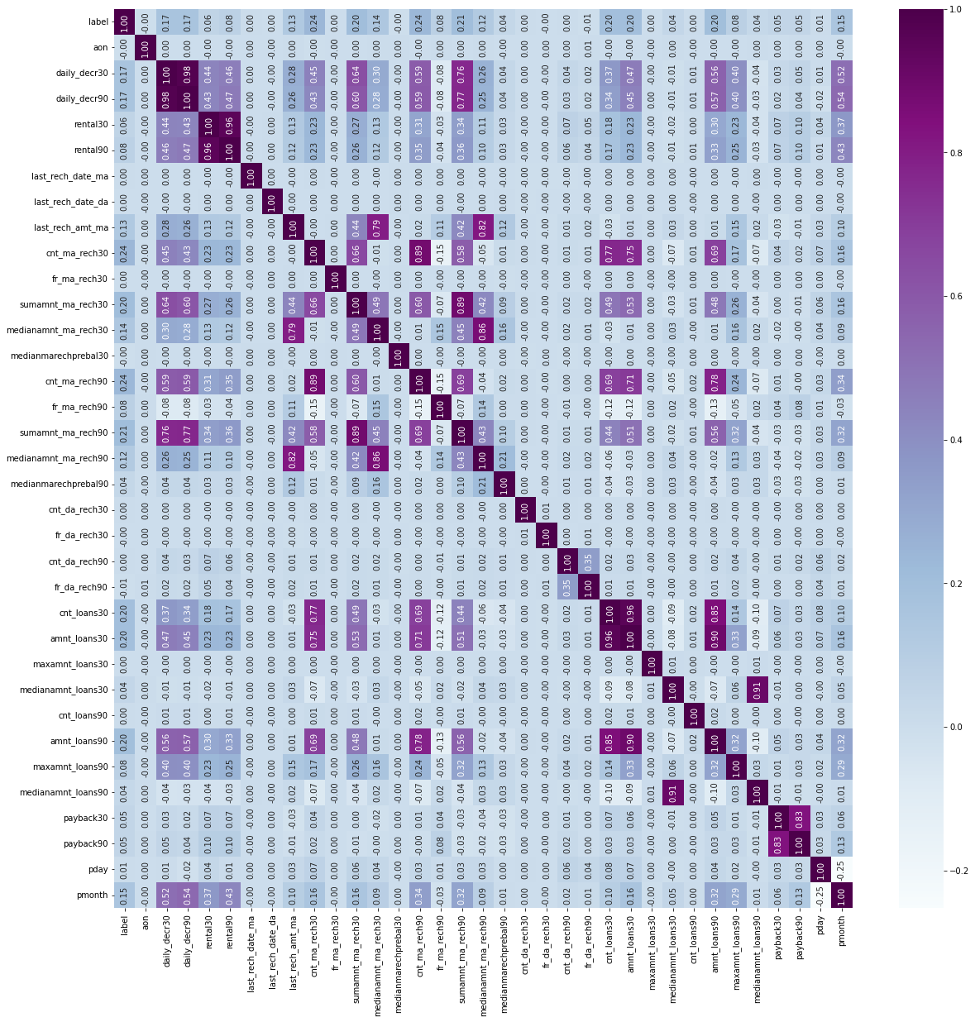
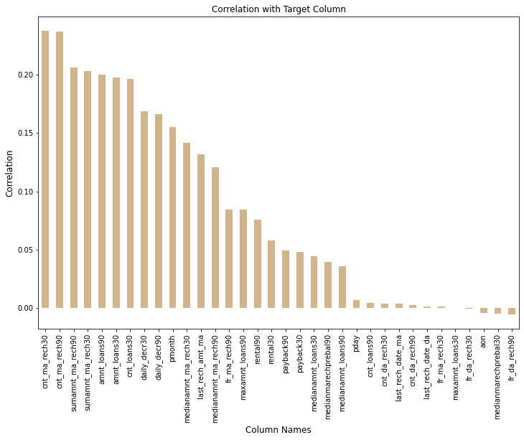
Correlation
Correlation of variables with target variable
Correlation of all variables

Slide 17
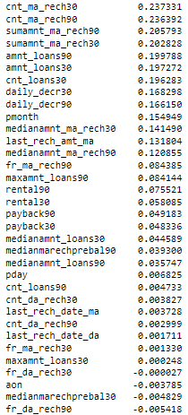
Observations:
Most of the columns are having positive correlation to the target variable.
The columns ['fr_da_rech30', 'aon', 'medianmarechprebal30', 'fr_da_rech90'] are having negative correlation to the target variable 'label'. Rest of the variables are having positive correlation to the target variable.
The column 'cnt_ma_rech30' is having highest positive correlation to the target variable 'label', while the column 'maxamnt_loans30' is having least positive correlation to the target variable 'label’.
The column 'fr_da_rech30' is having the least negative correlation to the target variable 'label', while the column 'fr_da_rech90' is having the highest negative correlation to the target variable 'label'.

Slide 18
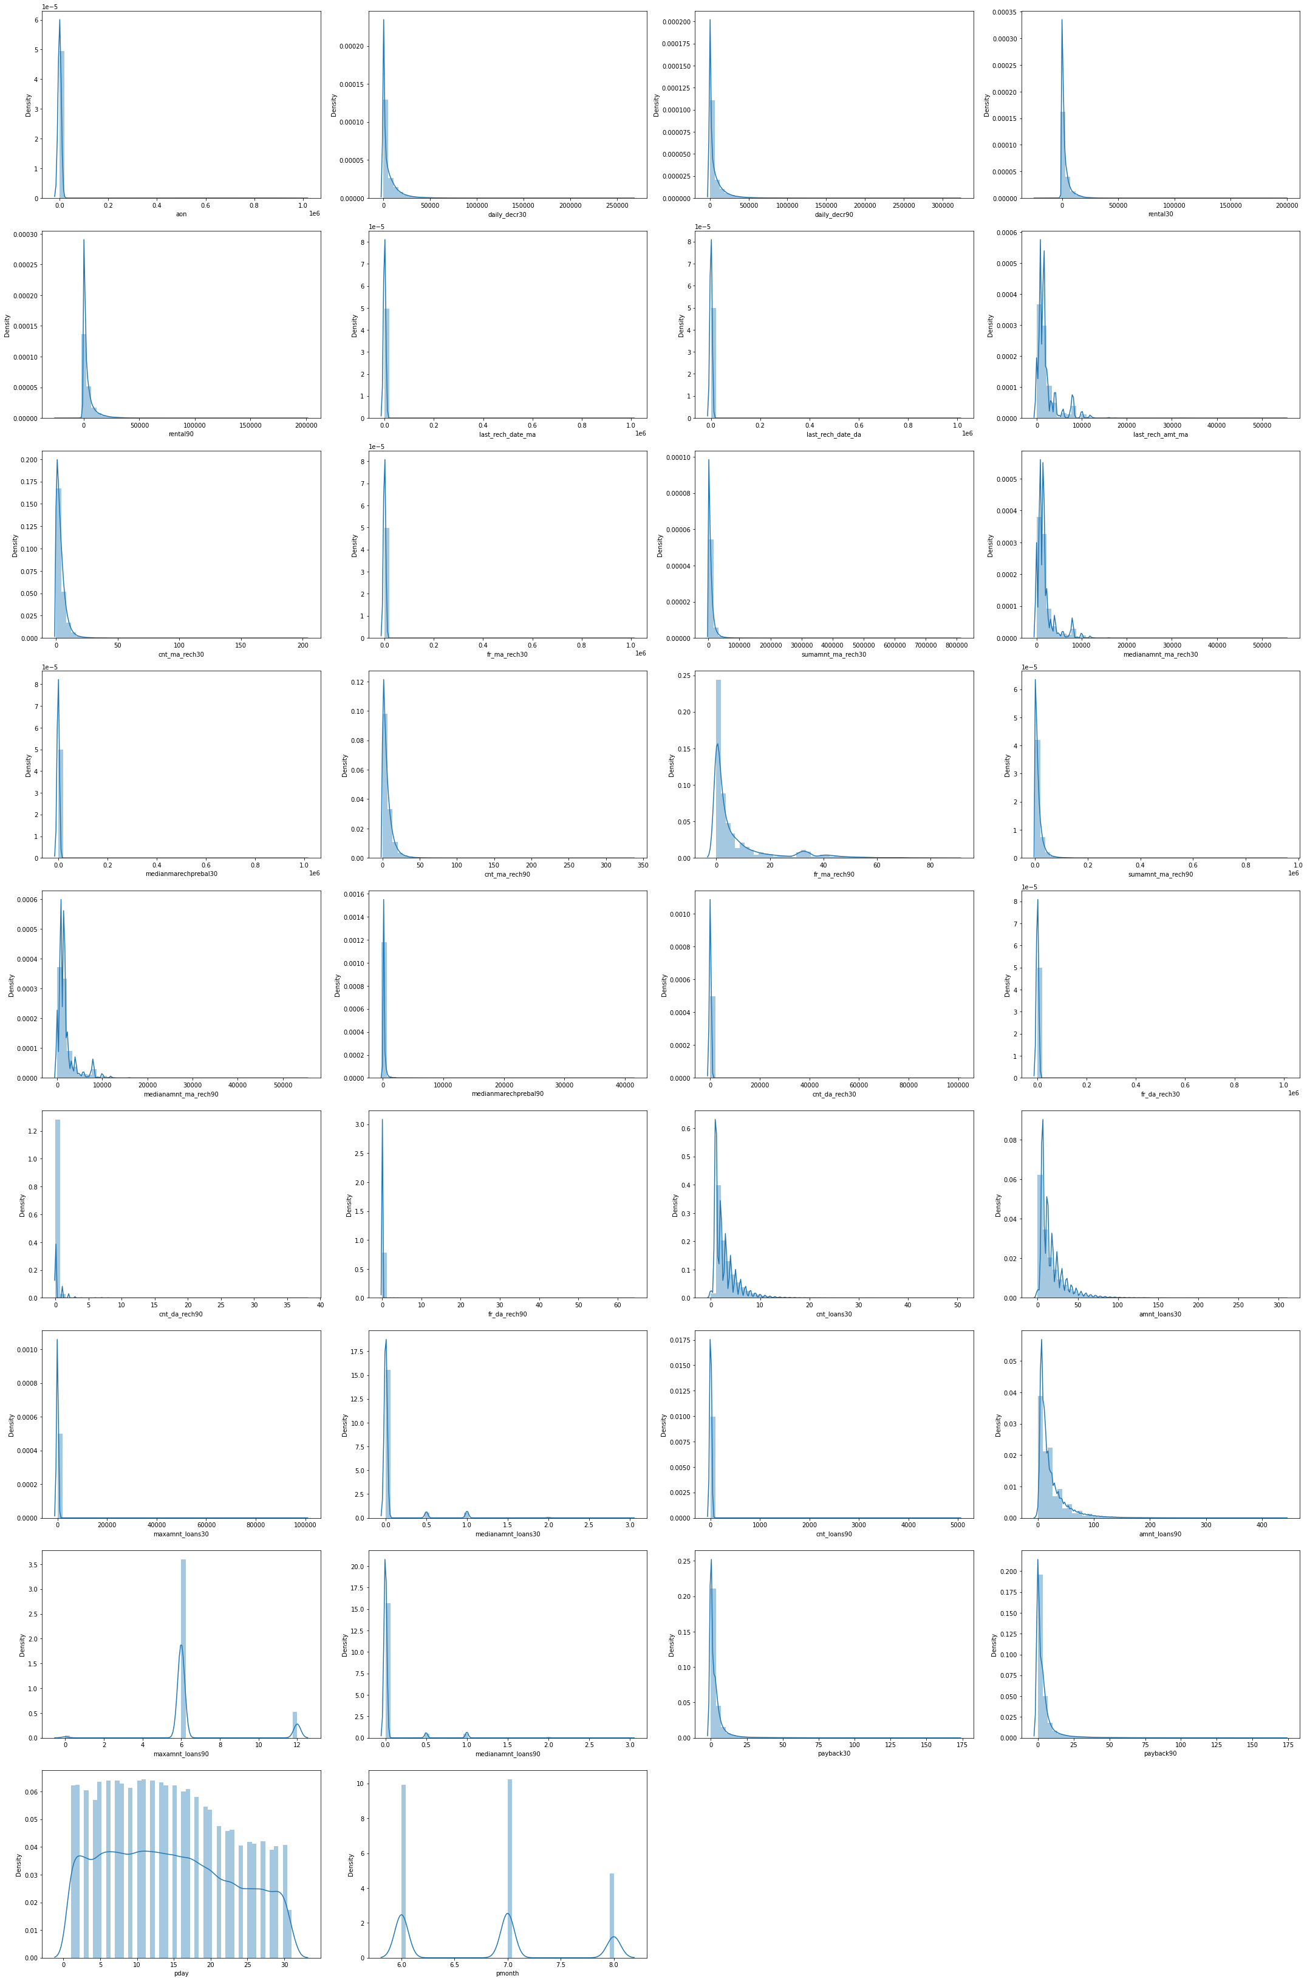
Distribution of Data in Numerical Columns (Skewness)
Observations:
None of the columns are having normal distribution of data.
All the columns except the columns ['pday', 'pmonth'] are having skewness and they are right skewed.
Skewness of Data

Slide 19
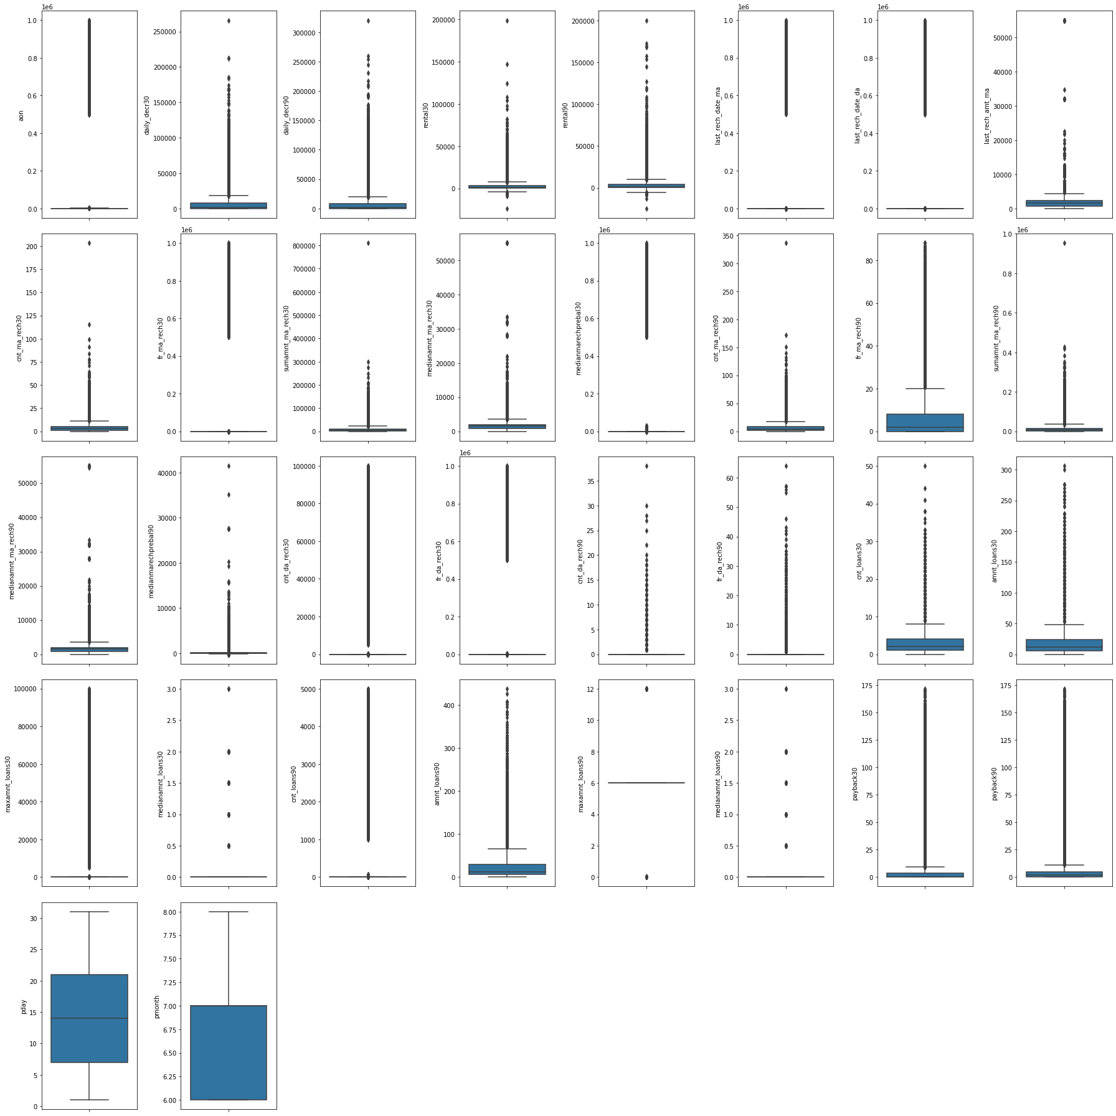
Presence of Outliers in Data
Observations:
All the columns except the columns ['pday', 'pmonth'] are having extreme outliers. We can handle these outliers in later step.
Outliers in dataset using boxplot

Slide 20
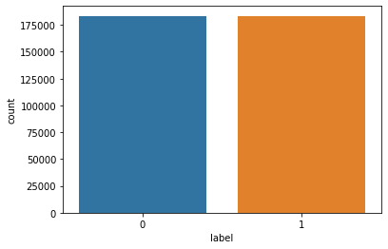
Data Cleansing
Checking whether the data is balanced or not
The data is not balanced and the records for non-defaulters is provided more in the datatset. So, we used SMOTE oversampling technique to balance the dataset.
Unbalanced data
Balanced Data

Slide 21
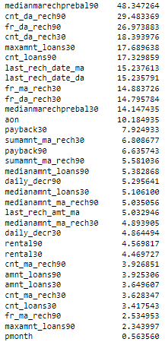
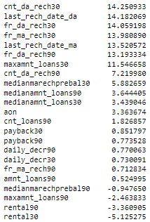
Removing the Skewness
The columns ['cnt_da_rech30', 'fr_ma_rech30','fr_da_rech30', 'last_rech_date_da', 'last_rech_date_ma', 'fr_da_rech90', 'maxamnt_loans30'] are having high skewness. So, we have dropped these columns from the dataset as these columns can have biased impact on the output.
Before reducing skewness of data
After adjusting skewness using power transform

Slide 22
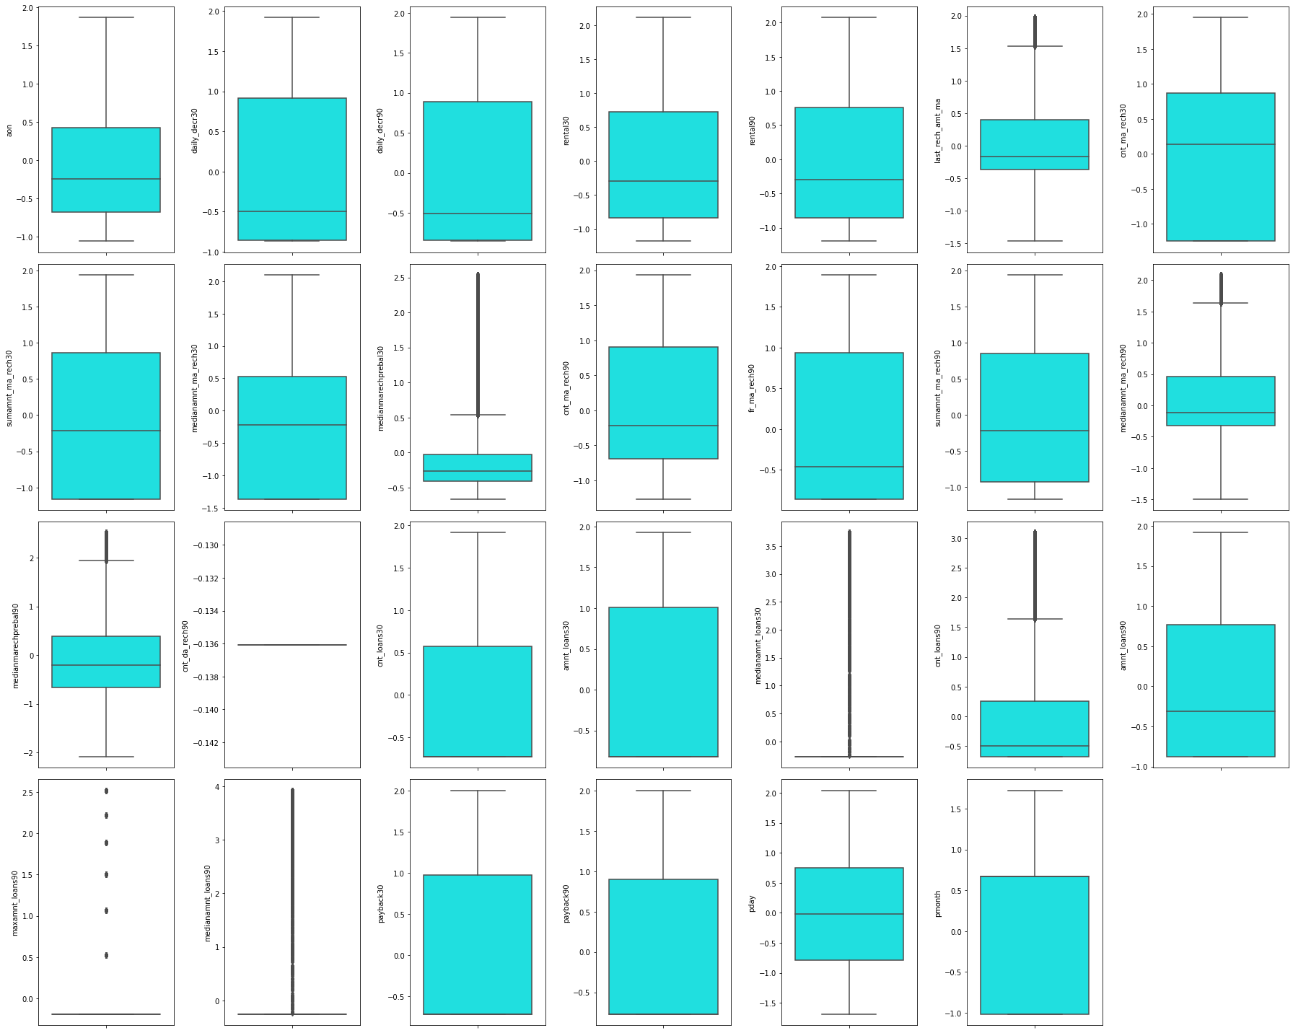
Removing the Outliers
We tried three outlier removal methods on the datasets:
Using Zscore method
Using Inter-quartile range (IQR)
Using percentile method
Out of which the percentile method was effective as it was not losing any data from the dataset after removing outliers. Since the data is important and we do not want to lose any crucial information from the dataset, we have proceeded with the percentile outlier removal method.
After removing outliers using percentile method, we were able to reduce the outliers up to an extent.
Outliers in dataset using boxplot after using percentile method

Slide 23
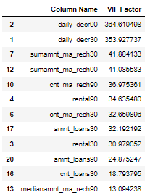
Multicollinearity from the Datasets.
These columns were having high multicollinearity, so we dropped the columns ['daily_decr30', 'sumamnt_ma_rech30','rental30', 'amnt_loans30'] so as to reduce the multicollinearity.
Columns with high VIF

Slide 24
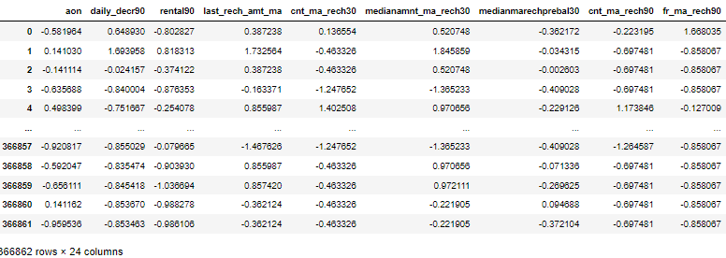
Final Dataset
Final Dataset after EDA and pre-processing

Slide 25
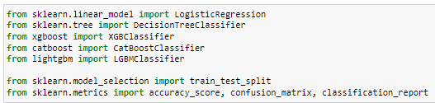

Model/s Development and Evaluation
Importing the required libraries for model building
Creating the instances of algorithms
We created three functions for testing the model and for cross validations:
best_ran: Finding the best random state for the selected model
mod_test: Training the model with the train data using the best random state.
cross_val: Finding the best cross validation mean score for each model.

Slide 26
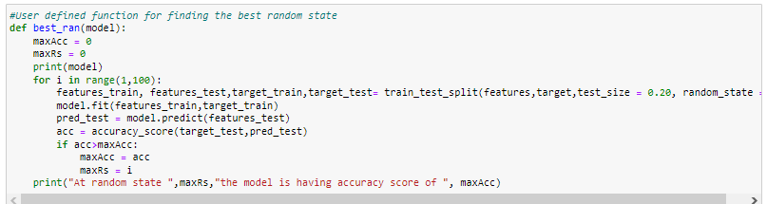
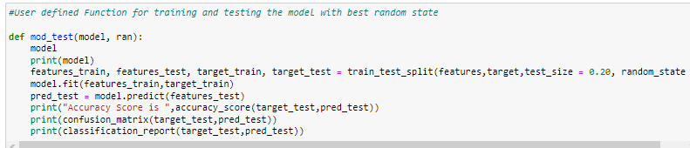
Testing of Identified Approaches (Algorithms) and evaluation of selected models
Code Snippet for function to find best random state
Code Snippet for function to test the model

Slide 27
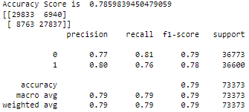
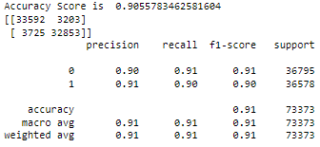
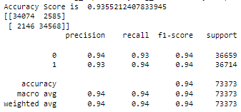
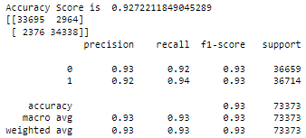
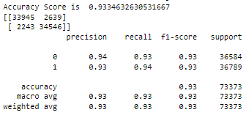
Logistic Regression
DecisionTree Classifier
XGB Classifier
Testing the model performance
Testing the model performance
Testing the model performance
LGBM Classifier
CatBoost Classifier
Testing the model performance
Testing the model performance
After testing the models, the xgb classifier(xgb) is performing well by providing the maximum accuracy score of 93.55%. After testing the models, the xgb classifier(xgb) is performing well by providing the maximum accuracy score of 93.55%.

Slide 28
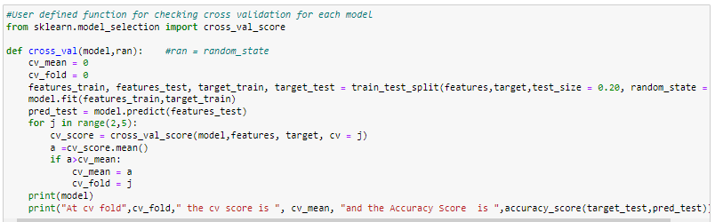
Cross Validation
Code Snippet for function to find the cross validation mean score
LogisticRegression
At cv fold 4 the cv score is 0.7816590794547977 and the Accuracy Score is 0.7859839450479059
DecisionTree Classifier
At cv fold 4 the cv score is 0.8985968400822768 and the Accuracy Score is 0.9066005206274788
XGB Classifier
At cv fold 4 the cv score is 0.9258223768870628 and the Accuracy Score is 0.9355212407833945
LGBM Classifier
At cv fold 3 the cv score is 0.9197056224400632 and the Accuracy Score is 0.9272211849045289
CatBoost Classifier
At cv fold 4 the cv score is 0.9243395300600212 and the Accuracy Score is 0.9334632630531667

Slide 29
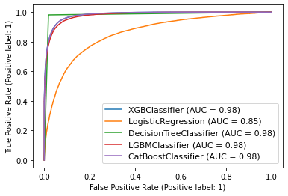
AUC ROC Curve
All the models except logistic regression model is providing the maximum AUC ROC score. Since the XGB model is performing well with all the training, testing, cross validations and auc score, we can consider this model as the best performing model.

Slide 30
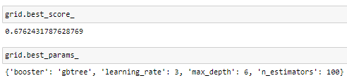
Hyperparameter Tuning
Best tuning score and best tuning parameters
After all the tests, cross validations and tuning the XGB classifier(xgb) model is performing well and providing maximum accuracy score of 93.55%.

Slide 31
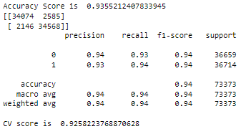
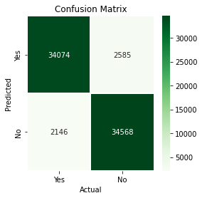

Finalized Model Performance
Final Model Performance
Saving the best model
We have saved the machine learning model for future predictions. We have serialized and saved the binary file as “micro credit defaulter prediction_model.pkl” using the pickle library.

Slide 32
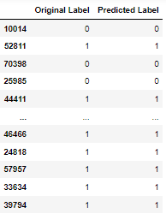
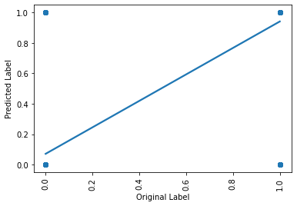
CONCLUSION
Now we have trained our model and it is ready to test with the actual data to cross verify the performance.
Model performance with predictions vs actual label
Model Predictions and Actual Label
Our model is performing well with predictions and provided accurate results.

Slide 33
Key Findings and Conclusions of the Study
With the help of data science and machine learning, we were able to create a machine learning model using XGBoost algorithm, which can predict whether the customer will be a defaulter or not.
Now this model can be used to predict whether a customer will be a defaulter or non-defaulter of credit repayment based on the following features:
cnt_ma_rech90 amnt_loans90 cnt_ma_rech30
sumamnt_ma_rech90 medianamnt_ma_rech90 cnt_loans30
last_rech_amt_ma cnt_loans90 medianamnt_loans90
medianamnt_loans30 payback30 payback90 medianamnt_ma_rech30
daily_decr90 pmonth medianmarechprebal90
medianmarechprebal30 rental90 maxamnt_loans90 fr_ma_rech90
pday cnt_da_rech90 aon
Impact of Variables on Target Variable (Correlation)
Most of the columns are having positive correlation to the target variable.
The columns ['fr_da_rech30', 'aon', 'medianmarechprebal30', 'fr_da_rech90'] are having negative correlation to the target variable 'label'. Rest of the variables are having positive correlation to the target variable.
The column 'cnt_ma_rech30' is having highest positive correlation to the target variable 'label', while the column 'maxamnt_loans30' is having least positive correlation to the target variable 'label'.
The column 'fr_da_rech30' is having the least negative correlation to the target variable 'label', while the column 'fr_da_rech90' is having the highest negative correlation to the target variable 'label'.

Slide 34
Limitations of this work and Scope for Future Work
Limitations
The data was vast, and the client tried to include all the important information that would benefit the model building. But the data was noisy, and we had to left out some part of data during the pre-processing.
Most of the features were having skewed data and huge outliers and high multicollinearity between the variables. This has resulted in complex model.
Even though the data included many crucial features that had impact on the output, there are still many other factors that influence the output such as the financial freedom of the customer, their spending behaviour, economic condition, inflation etc.
Scope
Future work may incorporate different relational learners, such as a network only link based classifier when a denser sample set of loans is available, given that network sparsity may also contribute to the substandard outcomes.
We can also consider including less noisy data as it will be helpful for the model to easily understand the patterns impacting the outcomes and also it will not lose much data during pre-processing, thus we can preserve the true nature of the data throughout the model building.
This study has only focused on whether the customer would be a defaulter or not, but there are other important inferences which can be beneficial to the company such as predicting the time of repayment of loan for each customer, chances of early settlement of loan etc.

Slide 35
Thank You

